Slide 1



Страновой офис ЮНИСЕФ в Казахстане
Навыки для девочек:
Программа по разработке наноспутников

Slide 2
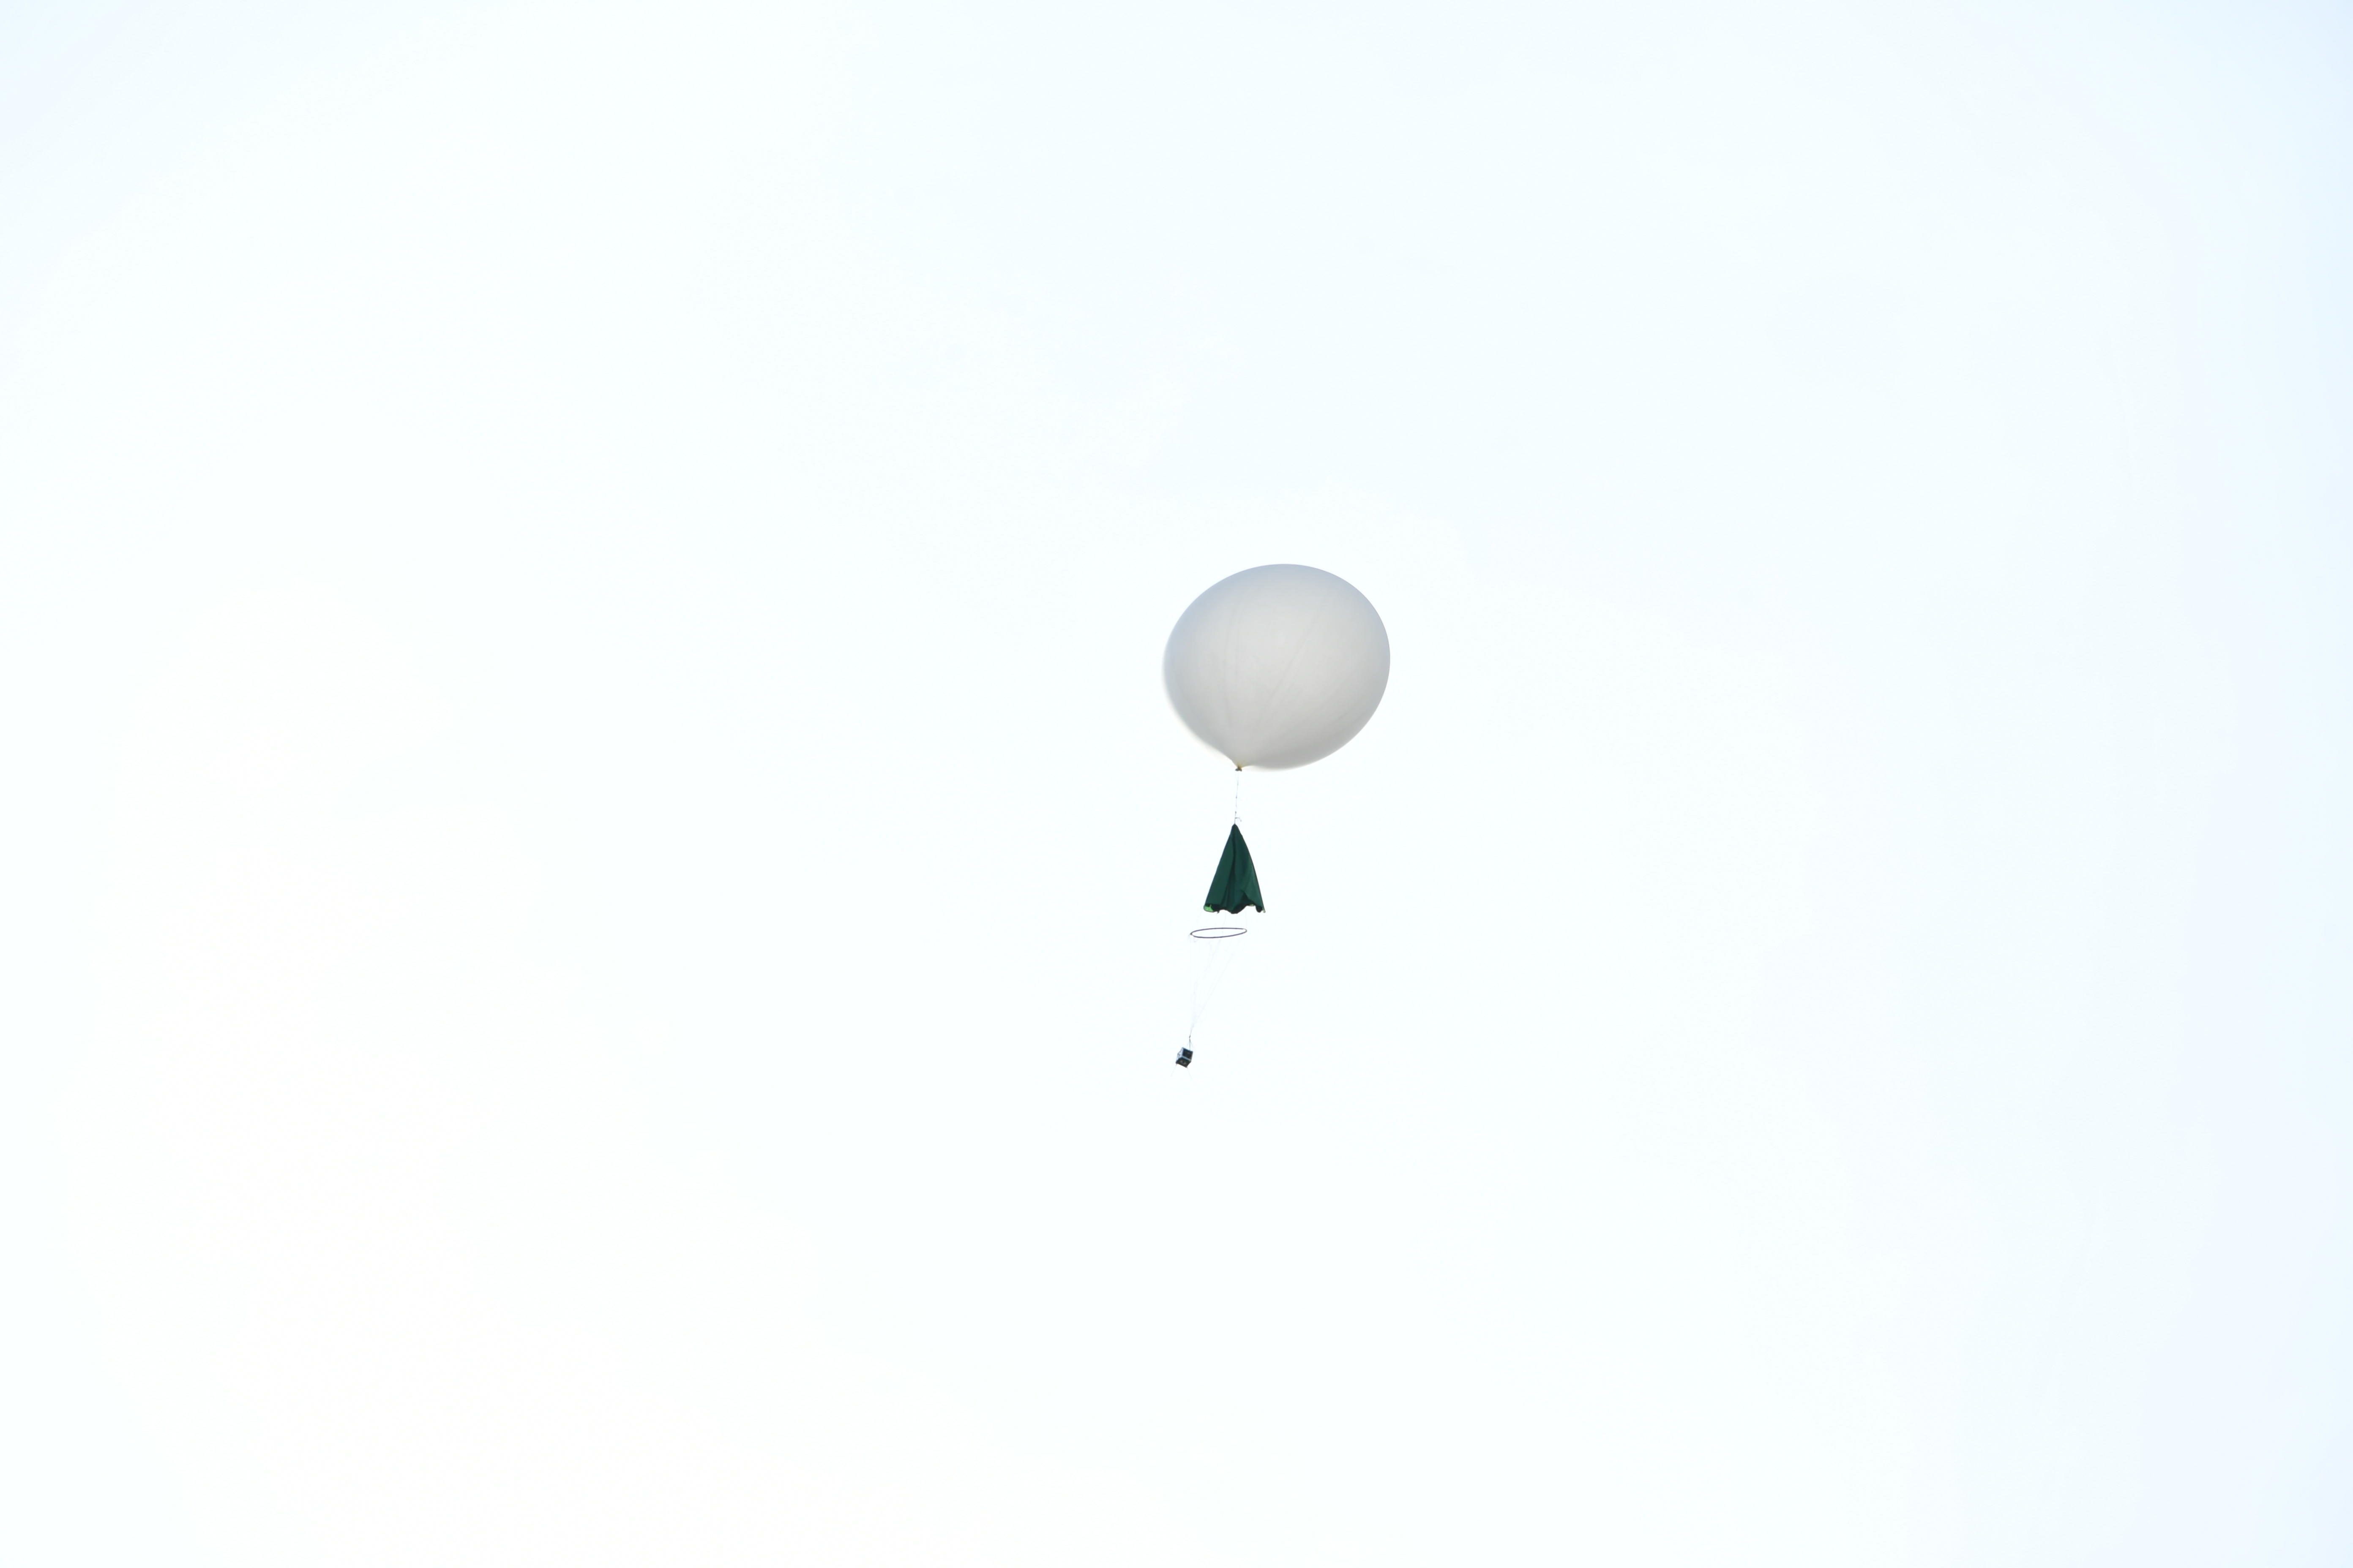
Запусти свою мечту: Образовательная программа по разработке наноспутников UniSat для девочек (UNEPG)
UNEPG является совместным проектом ЮНИСЕФ Казахстан и Казахского национального университета имени аль-Фараби

Slide 3
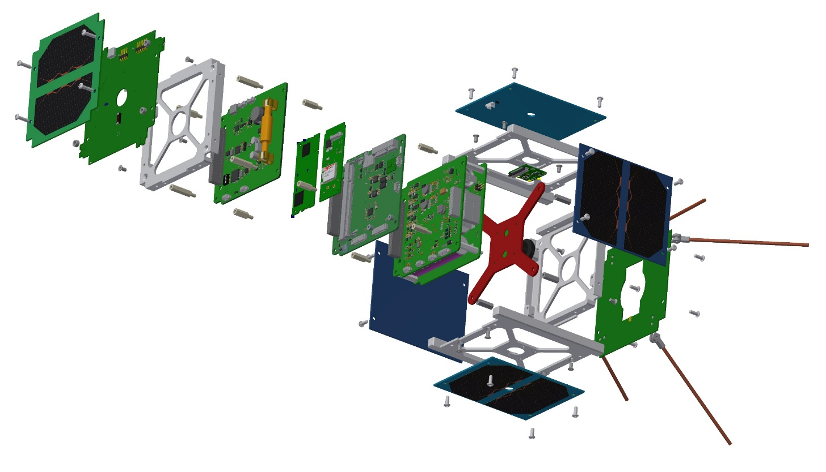


Lecture 2: Designing the OBC PCB
The Astro Pi Project
Introduction to the I2C Communication
Planning and Designing a RPi based OBC
Designing the OBC Prototype Using Fritzing
Designing the OBC PCB using KiCad
Printed Circuit Boards (PCBs) on the UniSat
kaznu.kz
sciencepark.kz
Notes:
In the previous lecture we have learned about OBC, it’s hardware components and main functions. In the beginning of this lecture, we will introduce the Astro-Pi project, and then we will familiarize ourselves with one of the most popular hardware communication interface called I2C, then We will introduce you the process of planning and designing a PCB, and in the end we will design a minimal OBC PCB using Fritzing and KiCad.

Slide 4
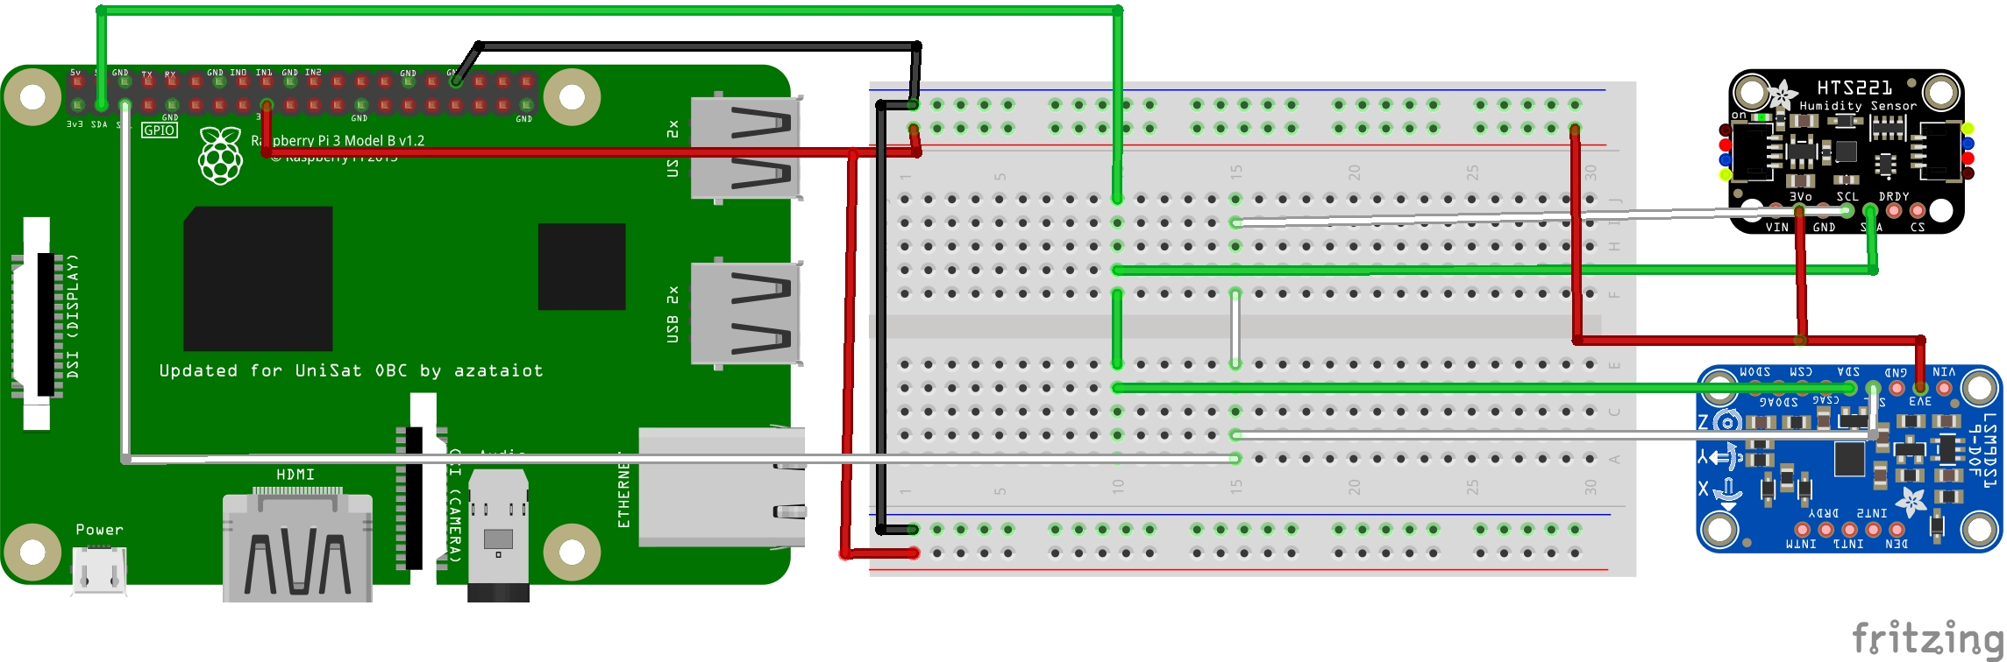
Lecture 2: Designing the OBC PCB
The Astro Pi Project
Introduction to the I2C Communication
Planning and Designing a RPi based OBC
Designing the OBC Prototype Using Fritzing
Designing the OBC PCB using KiCad
Designing a PCB using Fritzing
kaznu.kz
sciencepark.kz
Notes:
In the previous lecture we have learned about OBC, it’s hardware components and main functions. In the beginning of this lecture, we will introduce the Astro-Pi project, and then we will familiarize ourselves with one of the most popular hardware communication interface called I2C, We will introduce you the process of planning and designing a PCB, and in the end we will design a minimal OBC PCB using Fritzing and KiCad.

Slide 5
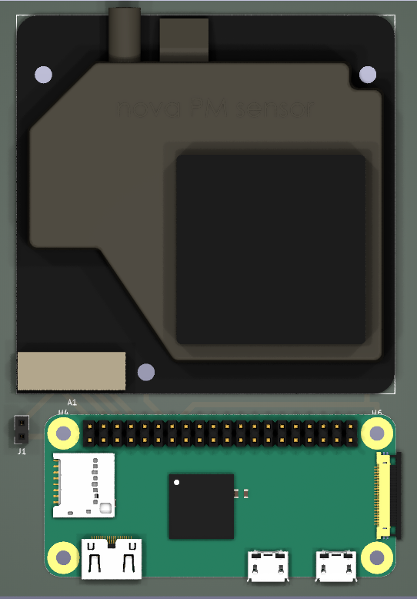
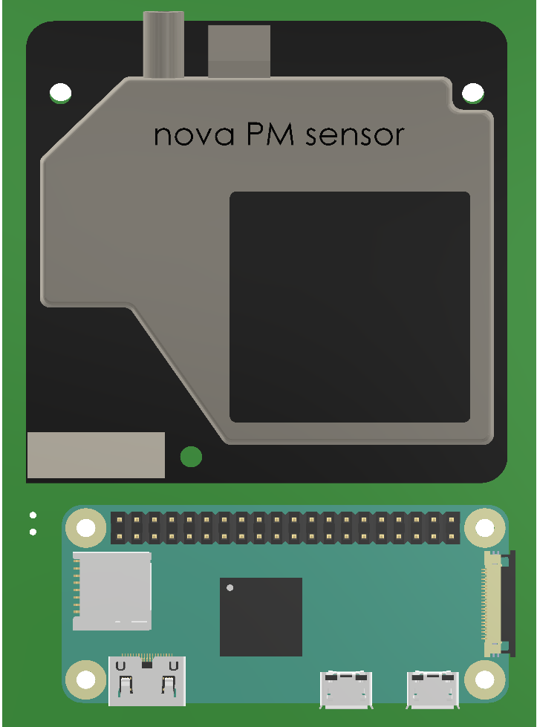
Lecture 2: Designing the OBC PCB
Designing a PCB using KiCad
kaznu.kz
sciencepark.kz
Notes:
In the previous lecture we have learned about OBC, it’s hardware components and main functions. In the beginning of this lecture, we will introduce the Astro-Pi project, and then we will familiarize ourselves with one of the most popular hardware communication interface called I2C, We will introduce you the process of planning and designing a PCB, and in the end we will design a minimal OBC PCB using Fritzing and KiCad.

Slide 6
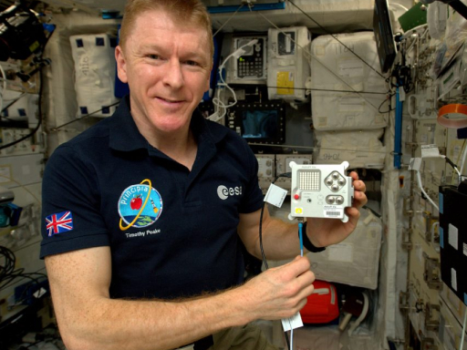
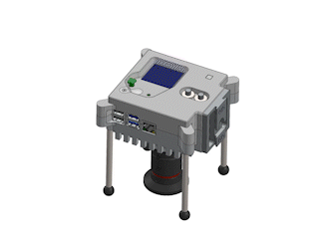
1. Astro Pi -- a Raspberry Pi Based Spacecraft
© Raspberry Pi Foundation
Inside the new Astro Pi Unit
© Astro-Pi.org
Astro PI in the International Space Station
kaznu.kz
sciencepark.kz
Notes:
Astro Pi is a European Space Agency’s Educational project run in collaboration with the Raspberry Pi Foundation. Astro Pi is a space craft designed based on the Raspberry Pi and also includes several sensors for measuring humidity, temperature, acceleration, gyroscope and magnetometry and etc.

Slide 7
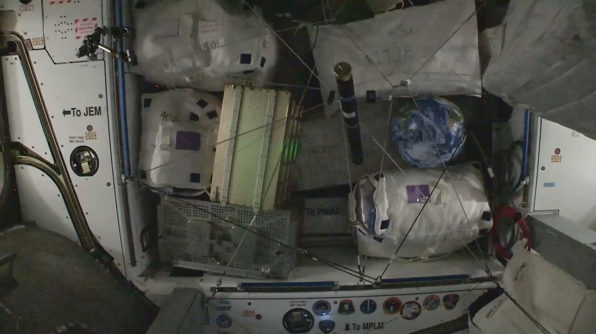
1. A spacecraft is a collection of different subsystems
kaznu.kz
sciencepark.kz
Notes:
Astro Pi is a European Space Agency’s Educational project run in collaboration with the Raspberry Pi Foundation. Astro Pi is a space craft designed based on the Raspberry Pi and also includes several sensors for measuring humidity, temperature, acceleration, gyroscope and magnetometry and etc.

Slide 8
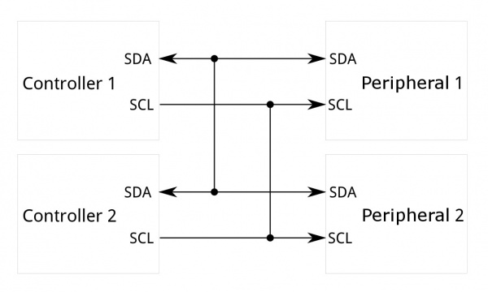
2. I2C – The hardware interface used in Astro Pi and many other
© Sparkfun.com
I2C Block Diagram
kaznu.kz
sciencepark.kz
Notes:
Many hardware devices, like Astro Pi and it’s sensors communicates with each other using one or more hardware interfaces and protocols. What we are going to introduce you today is the most popular and easy to use communication protocol named I2C.

Slide 9
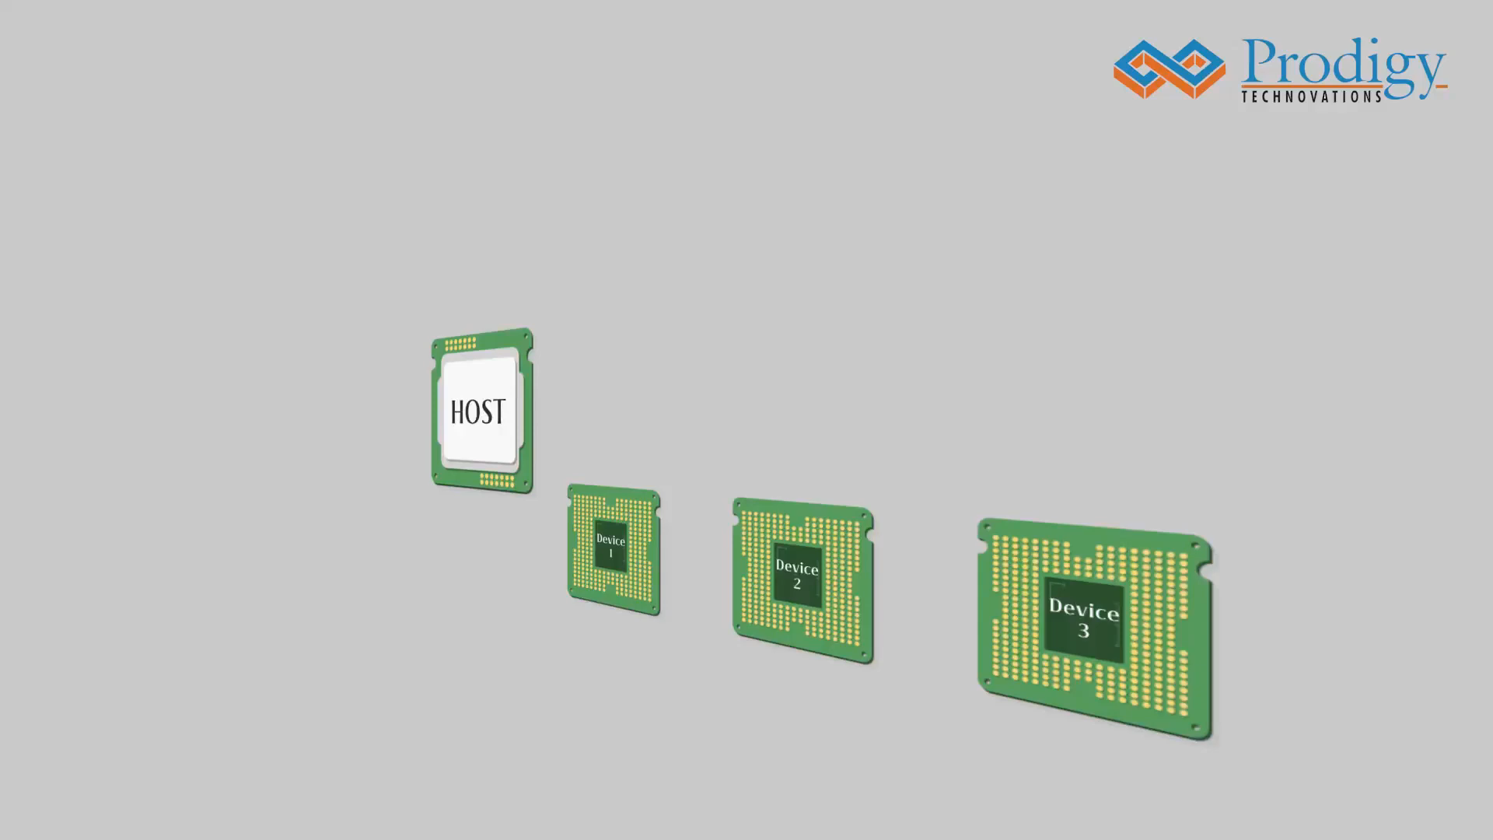
Raspberry Pi
kaznu.kz
sciencepark.kz
Notes:
0
00:00:01,000 --> 00:00:03,700
I2C is a simple two wire serial protocol
1
00:00:03,700 --> 00:00:04,866
used to communicate
2
00:00:04,900 --> 00:00:07,833
between two devices or chips in an embedded system
3
00:00:08,766 --> 00:00:11,600
it has two lines, scl and sda
4
00:00:12,666 --> 00:00:16,166
scl is used for clock and sda is used for data
5
00:00:17,166 --> 00:00:20,233
spi is a four wire serial communication protocol
6
00:00:20,333 --> 00:00:22,633
and it follows master slave architecture
7
00:00:23,400 --> 00:00:26,300
there are differences between I two c and spi
8
00:00:26,300 --> 00:00:29,166
such as I two c is half duplex communication
9
00:00:29,233 --> 00:00:32,066
and spi is full duplex communication
10
00:00:32,433 --> 00:00:35,600
it supports multi master and multi slave
11
00:00:35,600 --> 00:00:37,833
and spi supports single master
12
00:00:38,133 --> 00:00:40,266
i2c is a two wire protocol
13
00:00:40,266 --> 00:00:42,833
and spi is a four wire protocol
14
00:00:43,133 --> 00:00:45,166
i2c supports clock stretching
15
00:00:45,566 --> 00:00:47,633
it is slower than spi
16
00:00:49,066 --> 00:00:52,700
it has extra overhead start and stop bits
17
00:00:53,533 --> 00:00:55,533
it has an acknowledgment bit
18
00:00:55,533 --> 00:00:57,133
after every bite of transfer
19
00:00:58,733 --> 00:01:01,266
it has a pull up resistor requirement

Slide 10
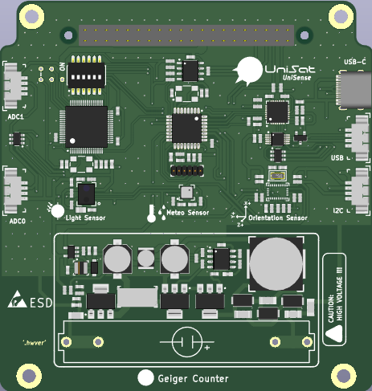
3. Planning our PCB design
Raspberry Pi as the main MPU
Measures:
Temperature
Humidity
Magnetometer
Accelerometer
Gyroscope
Communicates over I2C protocol
UniSense (Payload ) on the UniSat 1U Cubesat
kaznu.kz
sciencepark.kz
Notes:
After getting inspiration from the Astro Pi project, we want to plan and design our own hardware PCB for space. We want an industry standard and powerful unit for computing, and I believe Raspberry Pi is a nice choice for that.
After selecting our MPU or the micro processing unit, now its time to decide which functions are the essentials ones for our mission that we want to include in our hardware design.
It is very common for space hardware to have sensors for measuring temperature, humidity and we also want that.
We also want to include magnetemoter, accelerometer and gyroscope in our PCB so that those data later can be used for locating the coordinates of the satellite and also for calculating the spacecrafr’s speed.
After searching on the internet, I found that there are two sensors going to be the best match for our use case, they are the HTS221 and LSM9DS1 from ST Microcontrollers. And they also communicates with MPU using I2C protocol.

Slide 11

4. Prototyping the PCB Using Fritzing
© Fritzing
Fritzing is an Educational PCB designing program
kaznu.kz
sciencepark.kz
Notes:
Fritzing is an excellent open-source educational PCB design tool that usually used for quick prototyping. Let’s create a Fritzing project and design our PCB prototype.

Slide 12
Fritzing Video
kaznu.kz
sciencepark.kz
Notes:
Script at : https://github.com/UNEPG/fritzing-obc-blank

Slide 13

5. Designing the PCB Using KiCad
© Fritzing
KiCad is one of the most popular PCB designing software in the electronic industry
kaznu.kz
sciencepark.kz
Notes:
KiCad is one of the most popular PCB designing software in the electronic industry and has been widely used for many other projects.

Slide 14
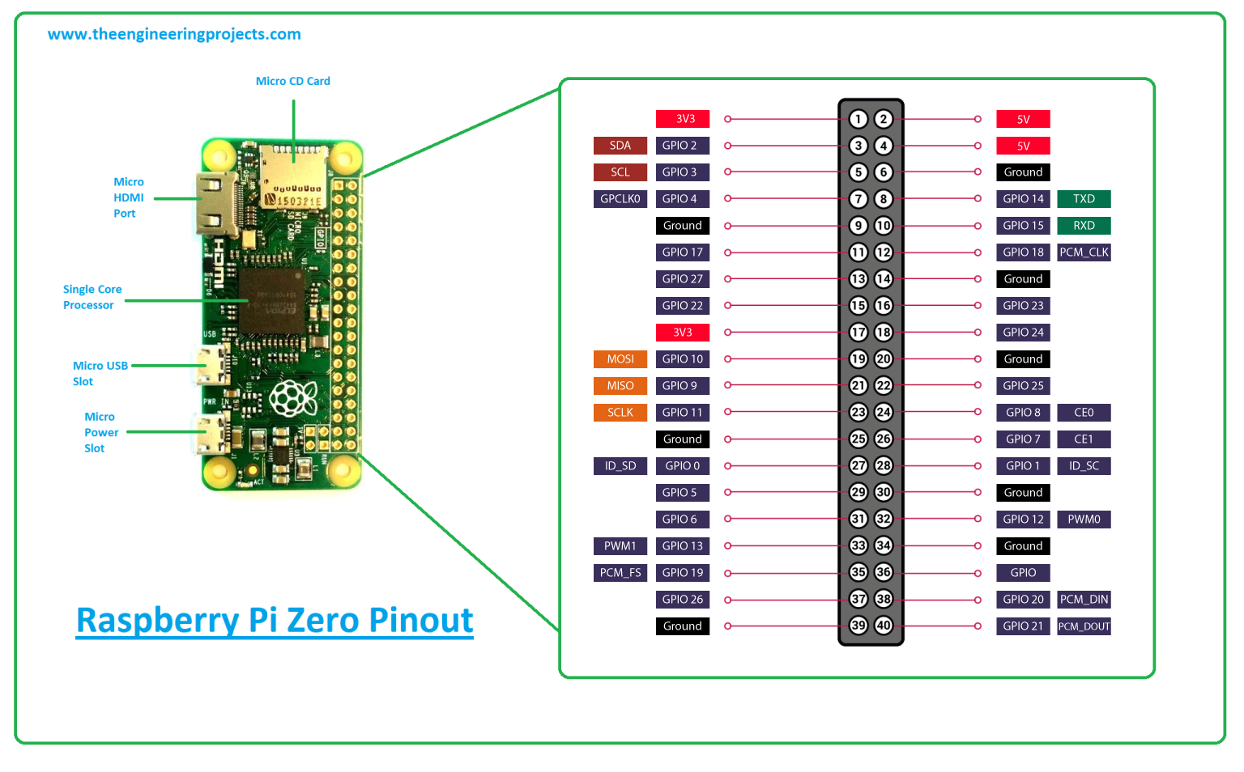
5. Raspberry Pi Pinouts
© Fritzing
Credit : The Engineering Projects
kaznu.kz
sciencepark.kz
Notes:
We need 3.3V, 5V power supply, Ground, I2C and UART lines from the raspberry Pi.

Slide 15
5. Raspberry Pi Pinouts
© Fritzing
Credit : The Engineering Projects
kaznu.kz
sciencepark.kz
Notes:
We need 3.3V, 5V power supply, Ground, I2C and UART lines from the raspberry Pi.

Slide 16
5. Raspberry Pi Pinouts
© Fritzing
Credit : The Engineering Projects
kaznu.kz
sciencepark.kz
Notes:
We need 3.3V, 5V power supply, Ground, I2C and UART lines from the raspberry Pi.

Slide 17
Here Comes Screen Recording Video (KiCad)
kaznu.kz
sciencepark.kz
Notes:
Script at : https://github.com/UNEPG/kicad-obc-blank

Slide 18

7. Review
Introduction
PCB Design
Software Development
You are here!
kaznu.kz
sciencepark.kz
Notes:
In this lesson, we have learned how to plan and design an OBC using Fritzing and KiCad. In the next lesson we are going to introduce you one of the most popular programming languages in the world.
See you on the next lesson, I wish you enjoy your study and have a nice day!

Slide 19
The following materials are used in this lecture.
Literature:
1. Honess, D. and Quinlan, O., 2017. Astro pi: Running your code aboard the international space station. Acta Astronautica, 138, pp.43-52.
2. Delgado, M., López, M.C. and Cid, C., 2020, July. Learning space weather through the Astro Pi Project: the experience at a Secondary School. In Contributions to the XIV. 0 Scientific Meeting (virtual) of the Spanish Astronomical Society (p. 256).
3. Bruce, R.F., Brock, J.D. and Reiser, S.L., 2015, April. Make space for the Pi. In SoutheastCon 2015 (pp. 1-6). IEEE.
4. Underwood, C., Pellegrino, S., Lappas, V.J., Bridges, C.P. and Baker, J., 2015. Using CubeSat/micro-satellite technology to demonstrate the Autonomous Assembly of a Reconfigurable Space Telescope (AAReST). Acta Astronautica, 114, pp.112-122.
Internet resources:
https://www.raspberrypi.org/blog/young-people-space-experiment-ideas-astro-pi-mission-space-lab-2021-22/
https://www.raspberrypi.org/blog/free-beginner-coding-activity-astro-pi-mission-zero-name-space-history/
https://astro-pi.org/about/
https://learn.sparkfun.com/tutorials/i2c/all
https://commons.wikimedia.org/wiki/File:KiCad-Logo.svg
https://commons.wikimedia.org/wiki/File:Fritzing_logo_(new).png
https://prodigytechno.com/i2c-vs-spi
https://www.youtube.com/watch?v=iKDeJi2VBNo (Youtube Channel Prodigy Technovations)
kaznu.kz
sciencepark.kz

